Slide 2
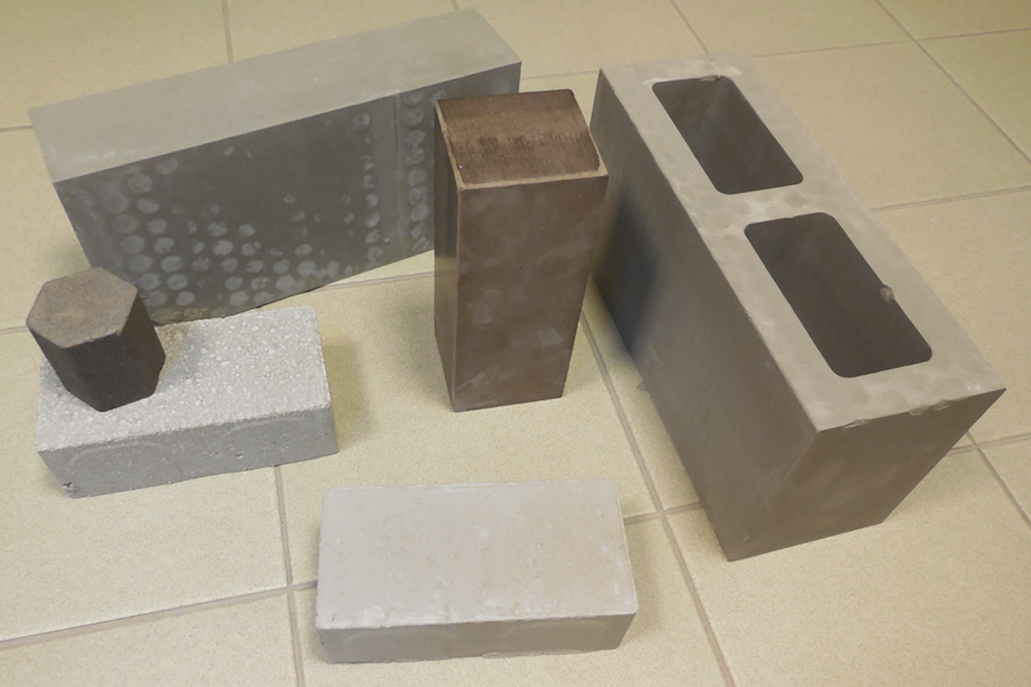
Carbstone technology 15 years of development Orbix’s innovative technology using CO₂ and waste streams for making building materials

Slide 3
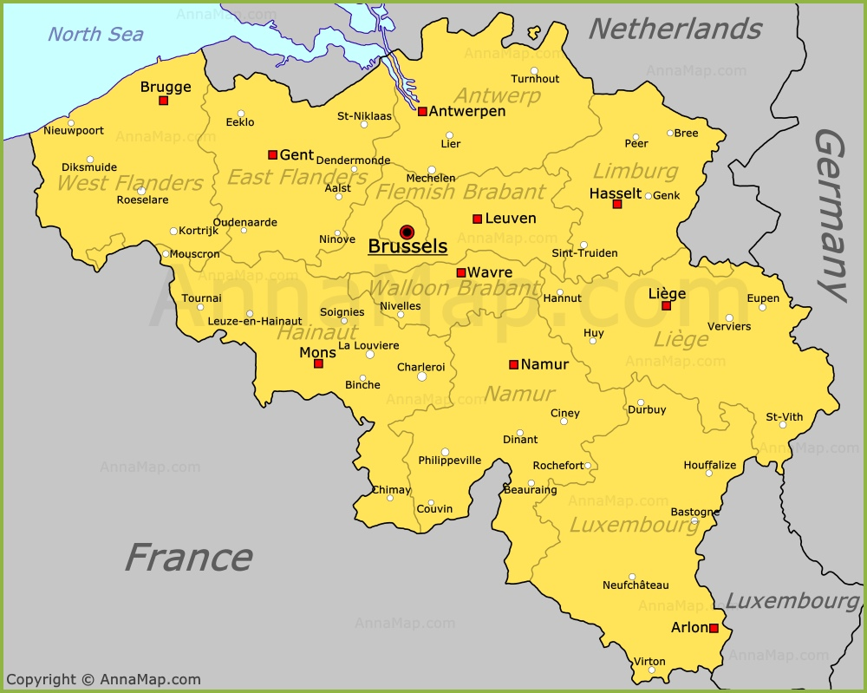
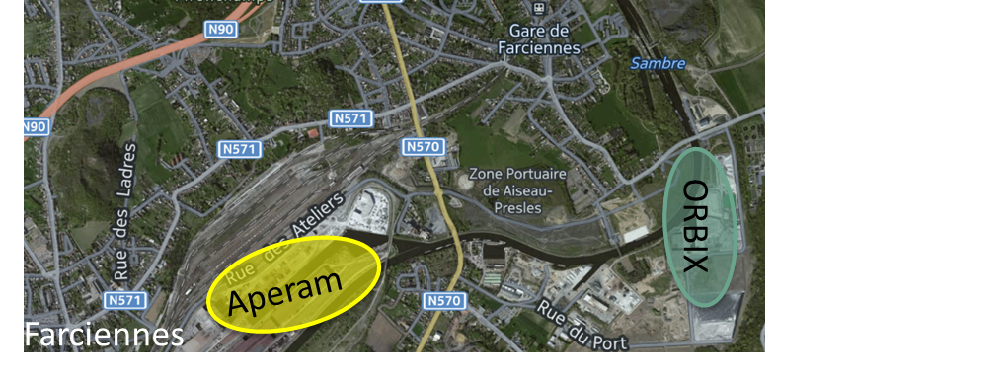
Orbix Belgium since 1994 A zero-waste company/industry Treatment and valorisation of slags from stainless steel production
400.000 – 600.000 ton/year stainless steel slags in Belgium
Before 1994: dumping of the slags
Since 1994 with Orbix: no dumping, metal recuperation and valorisation of the mineral fraction

Slide 4
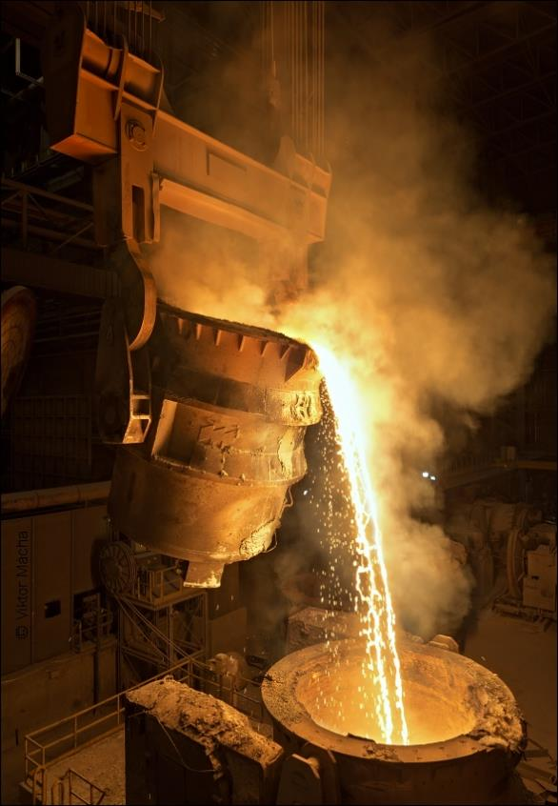
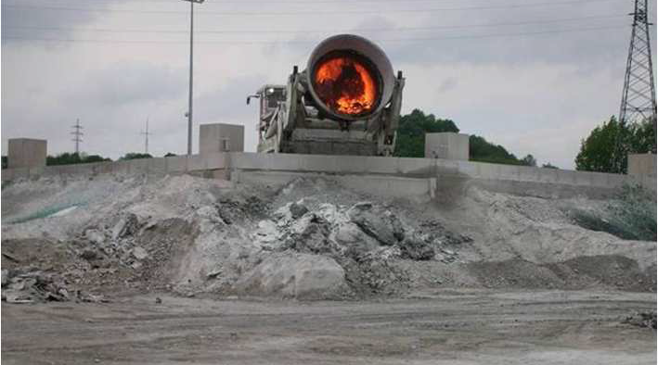
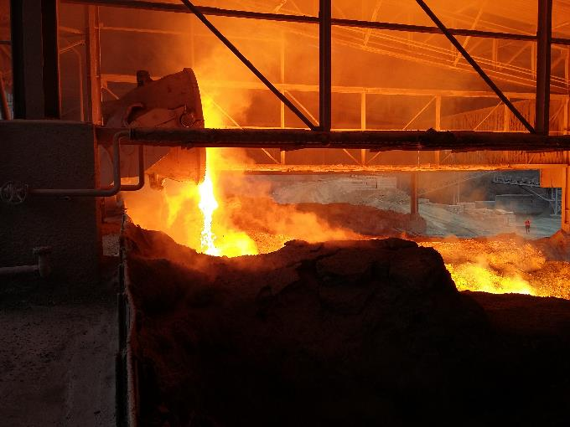
Slags formation
Slags are co-produced during the stainless steel production.
Slags are composed of all the additives (minerals) used for the steel production.
The slags are floating on the top of the produced liquid steel at +/- 1700 °C.
After cooling down the slags look like “rocks”.

Slide 5
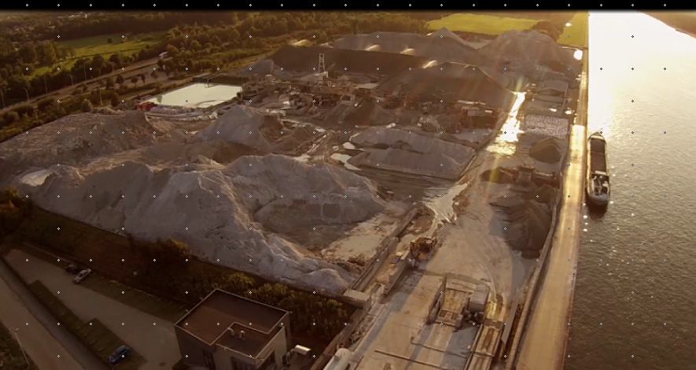
Orbix & Circular Economy
Stainless Steel
1 million ton/year
Stainless Steel Production
Slags
0,3 million ton/year
Scrap Slags
Stinox®
Fillinox®
?
Hand-picking, crushing, screening, demetallization and washing to obtain the desired quality

Slide 6
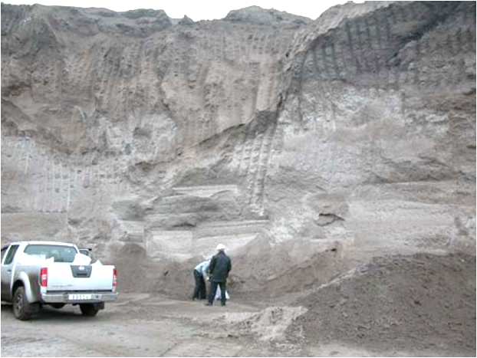
Piece of history !
2004
Why this big block now? First it was powder!
From
a simple conversation …
To the development of an
innovative technology…
Well, that is simply because of carbonation….
Really?
Hmmm…
Yes, actually, CO₂ from air reacts with…

Slide 7
Orbix & Circular Economy
Stainless Steel
1 million ton/year
Stainless Steel Production
Slags
0,3 million ton/year
Scrap Slags
Stinox®
Fillinox®
?

Slide 8
Orbix & Circular Economy
Stainless Steel
1 million ton/year
Stainless Steel Production
CO₂
Slags
0,3 million ton/year
Scrap Slags
Stinox®
Fillinox®
Carbinox®
Carbstone

Slide 9
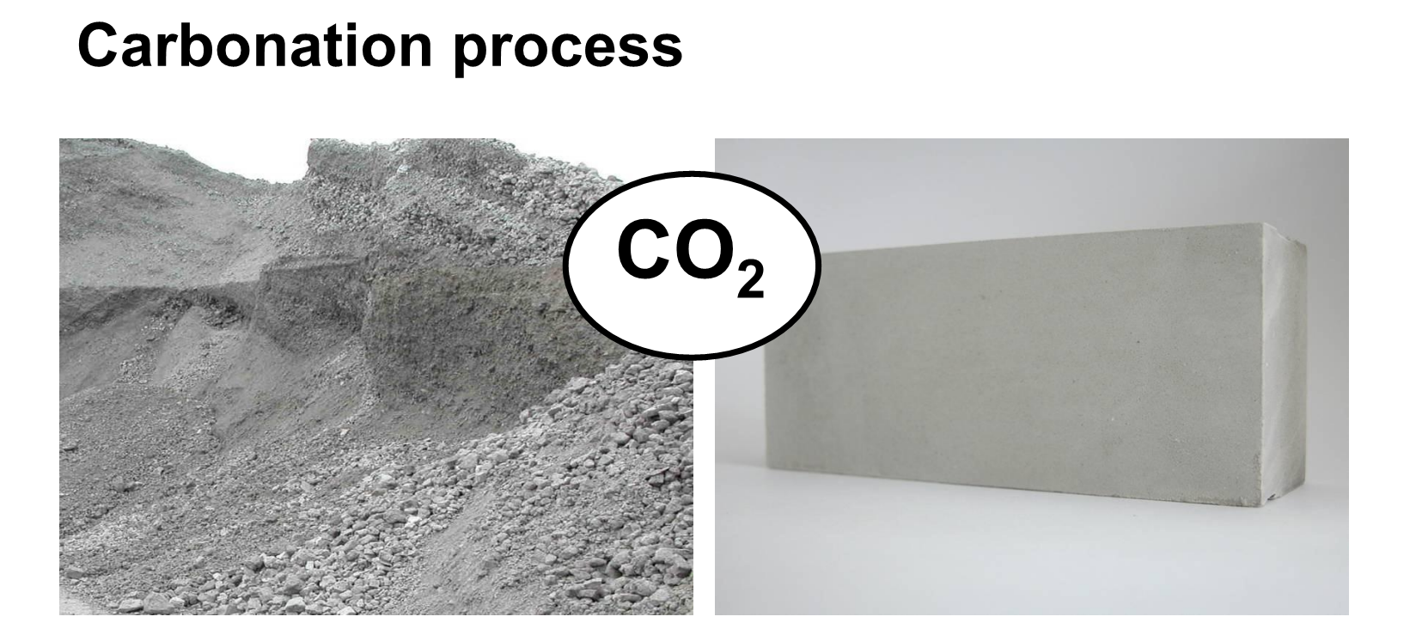
From 2004
Carbonation with Carbinox ®
CO₂ as binder
Material to carbonate: slags (or other waste streams)
In combination with natural materials
No cement needed anymore
Faster curing than cement (12 h <-> 7 days)
Building materials with very low carbon footprint

Slide 10
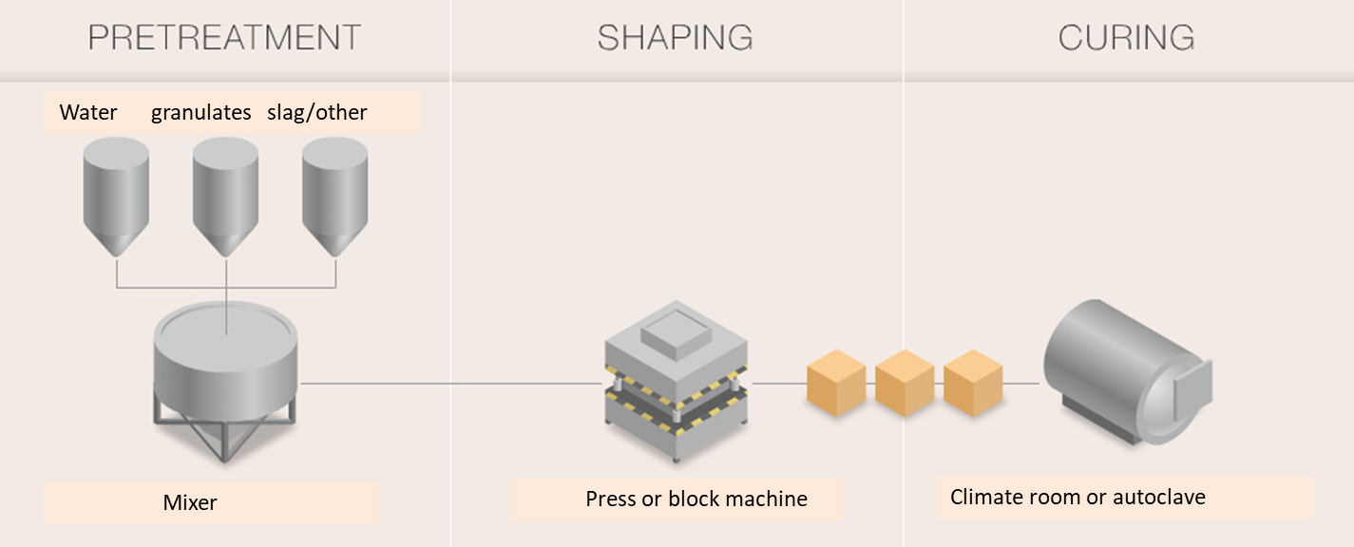
Lab-scale studies
Methods
Compaction using hydraulic press
Autoclave 5 to 75 bar
Curing time 16 h
100% CO₂ atmosphere
Temperature of 140 °C
Materials
Slags rich in CaO
M. Quaghebeur et al., 2010, Carbstone: Sustainable Valorisation Technology for Fine Grained Steel Slags and CO2, Refractories Worldforum 2010
M. A. Boone et al., 2015, Monitoring of Stainless-Steel Slag Carbonation Using X‑ray Computed Microtomography, Environ. Sci. Technol. 2014, 48, 674−680
Notes:
The calculated maximum theoretical CO2 sequestration capacity is 420 g CO2/kg for steel slag (when both Ca and Mg are considered) and 337 g CO2/kg for LD steel slag (amount of CO2 expressed on basis of non-carbonated steel slag).

Slide 11
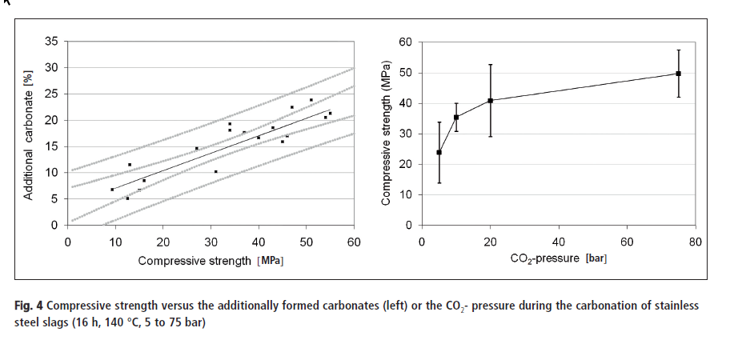
Correlation between CO₂-pressure and strength development
High amount of carbonates = high compressive strength in the blocks
Elevated carbonation pressure
Advantageous for the strength development of the carbonated materials
But higher production costs and investments costs (process less attractive from an economic point of view)
M. Quaghebeur et al., 2010, Carbstone: Sustainable Valorisation Technology for Fine Grained Steel Slags and CO2, Refractories Worldforum 2010
M. A. Boone et al., 2015, Monitoring of Stainless-Steel Slag Carbonation Using X‑ray Computed Microtomography, Environ. Sci. Technol. 2014, 48, 674−680
Notes:
Correlation between the strength of the carbonated material and the amount of additional formed carbonates during the carbonation reaction

Slide 12
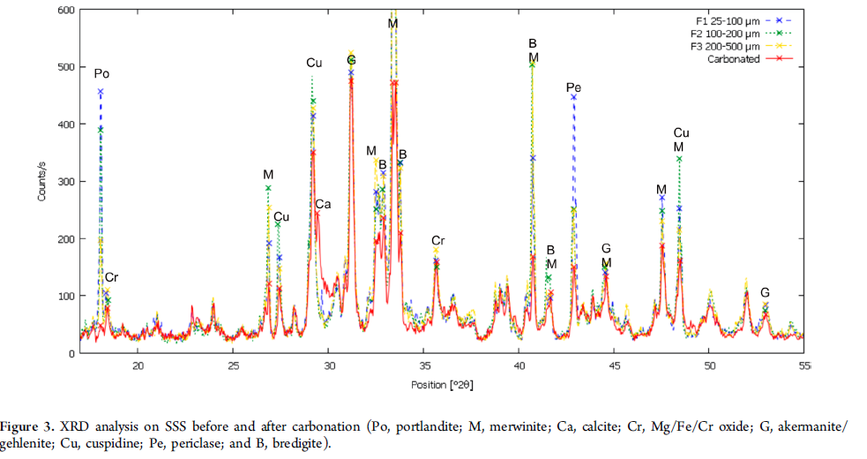
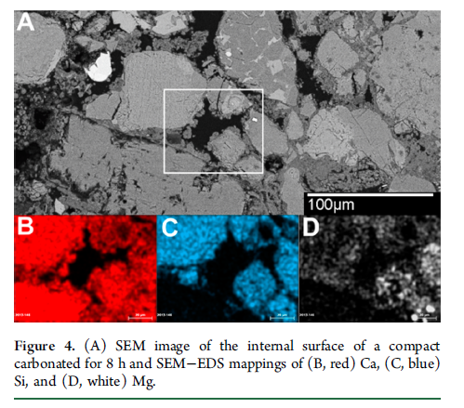
Calcium leaching and carbonates precipitation
After 8 h of carbonation, changes in mineralogy:
portlandite phase no longer present
Decrease of the intensity of the diffraction peaks of
merwinite, cuspidine, bredegite, periclase,
and akermanite−gehlenite
Calcite has appeared
The carbonate crystals are preferentially located at the grain contacts
Calcium (and magnesium) have been dissolved from the outer layer of the silicate minerals, leaving a cation-depleted silica-rich layer behind
The dissolved calcium and part of the silicon from the silicates will precipitate in the pore network of the slag, further strengthening the compact
M. Quaghebeur et al., 2010, Carbstone: Sustainable Valorisation Technology for Fine Grained Steel Slags and CO2, Refractories Worldforum 2010
M. A. Boone et al., 2015, Monitoring of Stainless-Steel Slag Carbonation Using X‑ray Computed Microtomography, Environ. Sci. Technol. 2014, 48, 674−680

Slide 13
Environmental quality of carbonated building materials
Batch leaching test (EN12457-4)
Fresh granular stainless steel slag
chromium (leachability: 0,66 mg/kg)
molybdenum (leachability: 0,42 mg/kg).
Carbonated stainless steel slag (16 h, 20 bar, 140 °C)
Reduction of the leaching of chromium and molybdenum to the level that the carbonated steel slags complied with the limit values for landfilling of inert waste
Cr 0,014 mg/kg
Mo 0,14 mg/kg
M. Quaghebeur et al., 2010, Carbstone: Sustainable Valorisation Technology for Fine Grained Steel Slags and CO2, Refractories Worldforum 2010
M. A. Boone et al., 2015, Monitoring of Stainless-Steel Slag Carbonation Using X‑ray Computed Microtomography, Environ. Sci. Technol. 2014, 48, 674−680

Slide 14
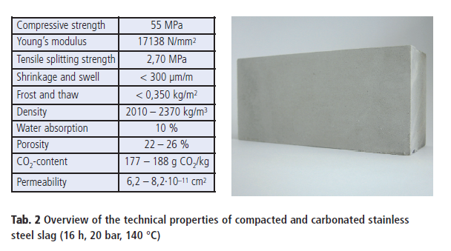
Properties of the obtained block
Process conditions should be chosen to avoid
water saturation of the pores
blockage of the pores by precipitation of carbonates formed
M. Quaghebeur et al., 2010, Carbstone: Sustainable Valorisation Technology for Fine Grained Steel Slags and CO2, Refractories Worldforum 2010
M. A. Boone et al., 2015, Monitoring of Stainless-Steel Slag Carbonation Using X‑ray Computed Microtomography, Environ. Sci. Technol. 2014, 48, 674−680

Slide 15
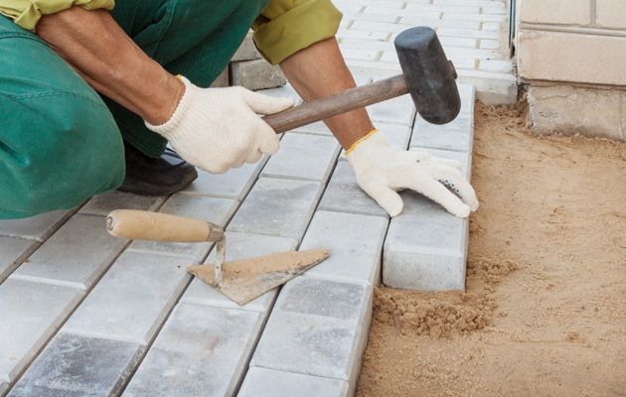
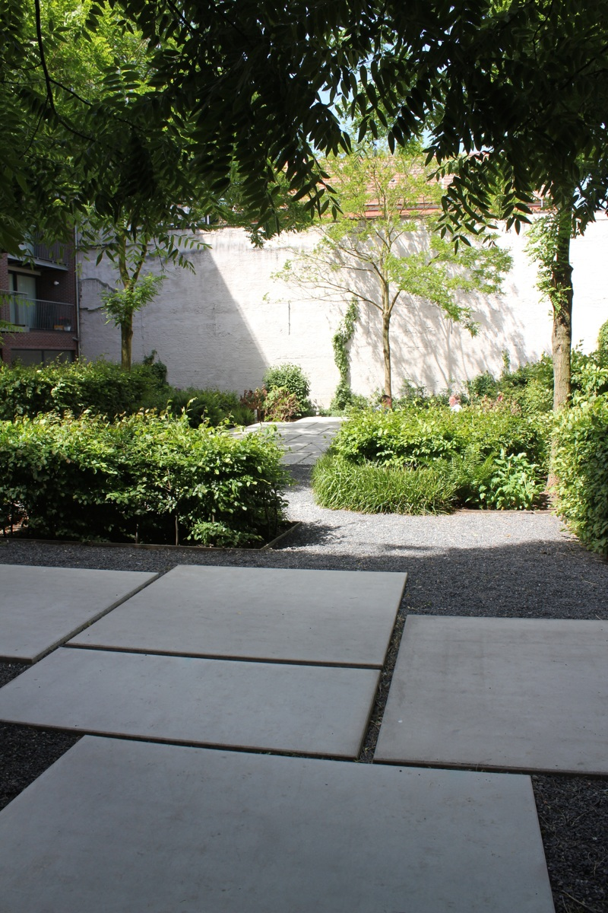
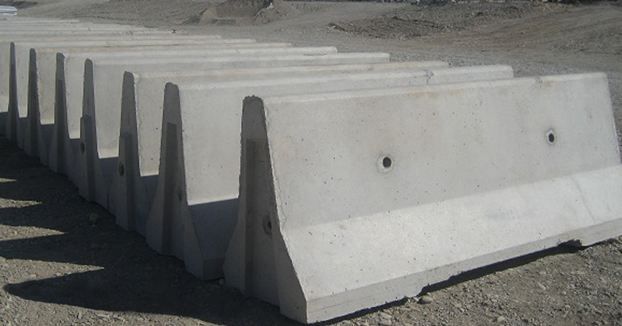
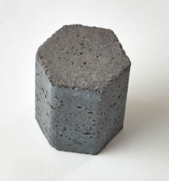
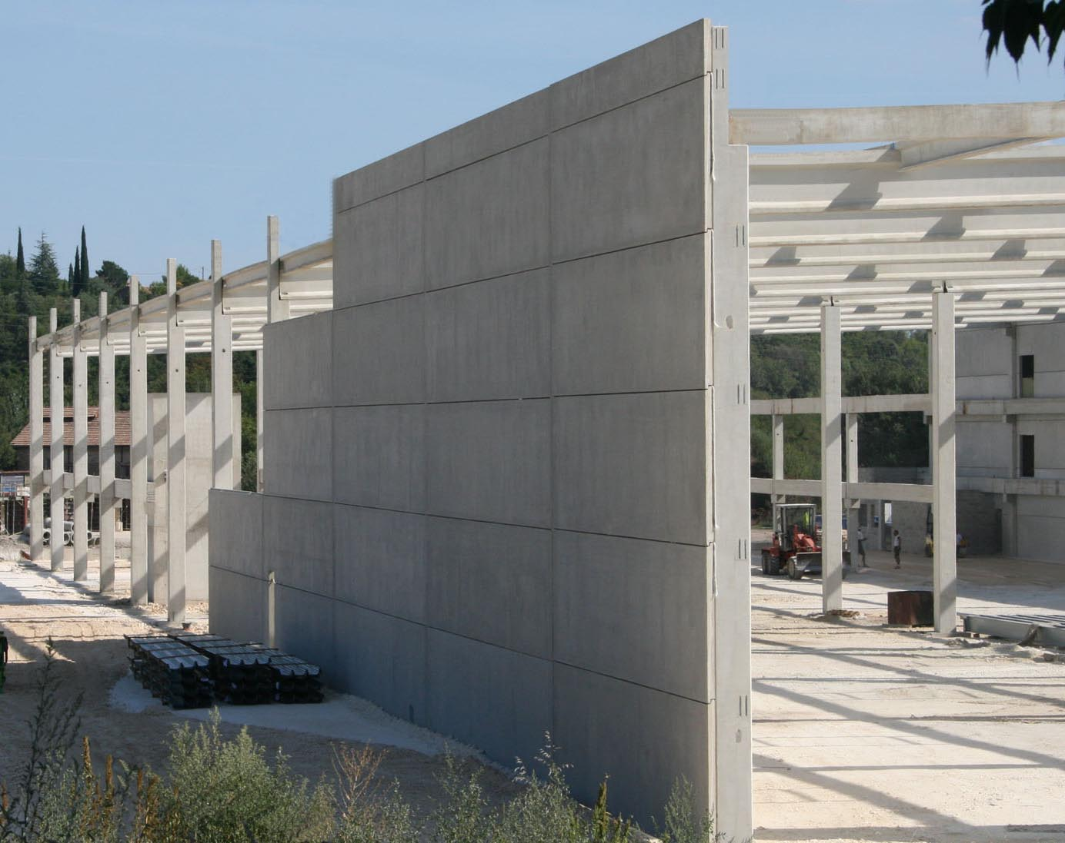
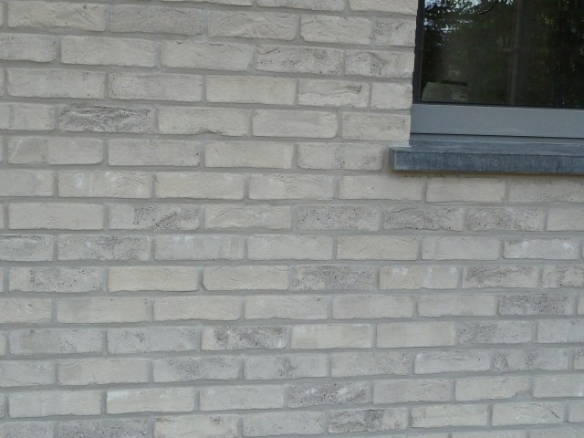
Ongoing trials

Slide 16
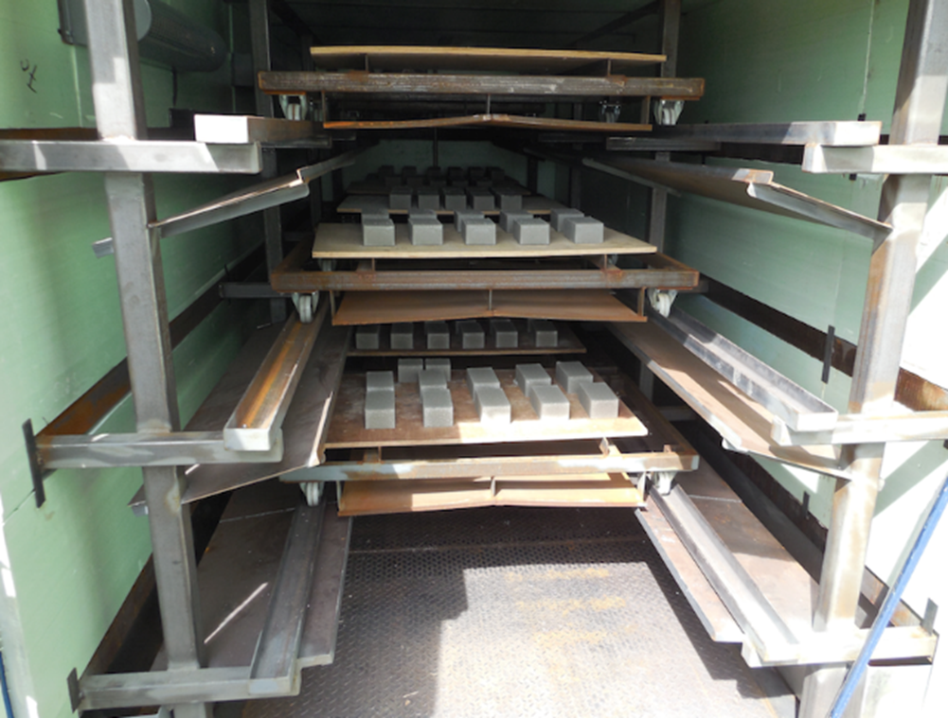
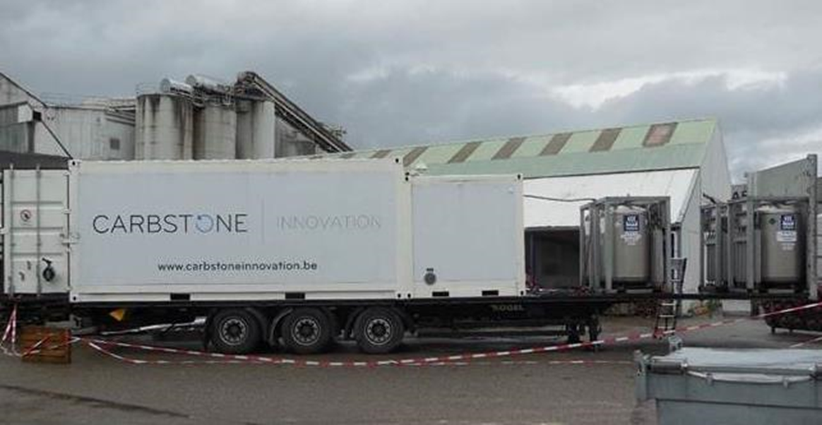
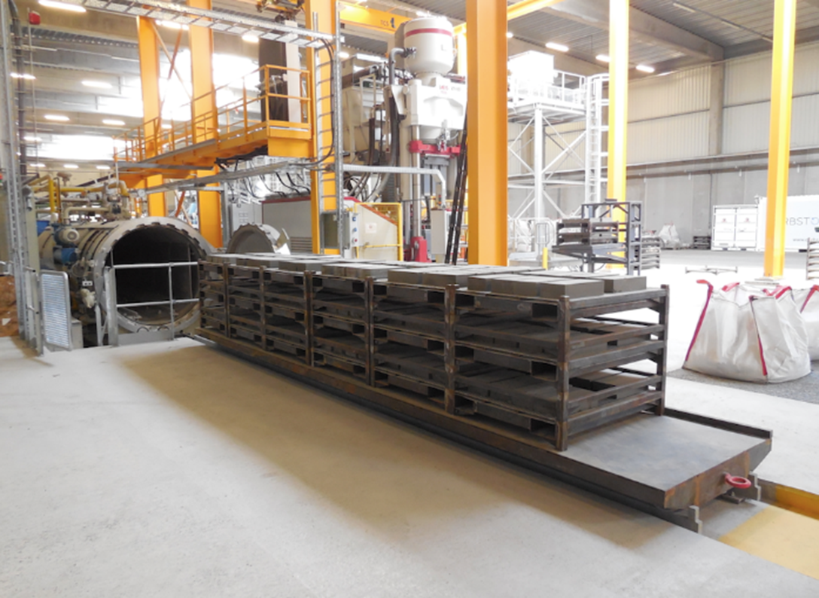
Mobile testing unit
& Pilot plant Farciennes

Slide 17
Carbinox - CO₂ balance
CO₂ capture with Carbinox
-150,0 kg CO₂/ton Carbinox
Steel mill: 0,0 kg CO₂/ton Carbinox
Grinding, …: 9,3 kg CO₂/ton Carbinox
Conditioning: 67,6 kg CO₂/ton Carbinox
Total: 76,9 kg CO₂/ton Carbinox
Total: - 73,1 kg CO₂ / ton Carbinox

Slide 18
Carbstone, CO2 balance
CO₂-binding during production:
-0,30 ton CO₂/m³ Carbstone blocks
CO₂ produced during production:
+0,08 ton CO₂/m³ (energy demand 200 kWh/m³)
CO₂ saved by not using cement:
-0,24 ton CO₂/m³ concrete block
Total CO₂ balance:
-0.46 ton CO₂/m³ concrete block

Slide 19
Partnerships

Slide 20
CO₂
Source
Carbonatable material
Producer of construction materials
Tests in labo
Tests in pilot plant
Tests in mobile container
Patents -> Licences
Industrial implementation
Carbonation
Technology

Slide 21
CO₂ Value Europe
The industry association dedicated to Carbon Capture & Utilization (CCU)
March 2019 www.co2value.eu
contact@co2value.eu

Slide 22
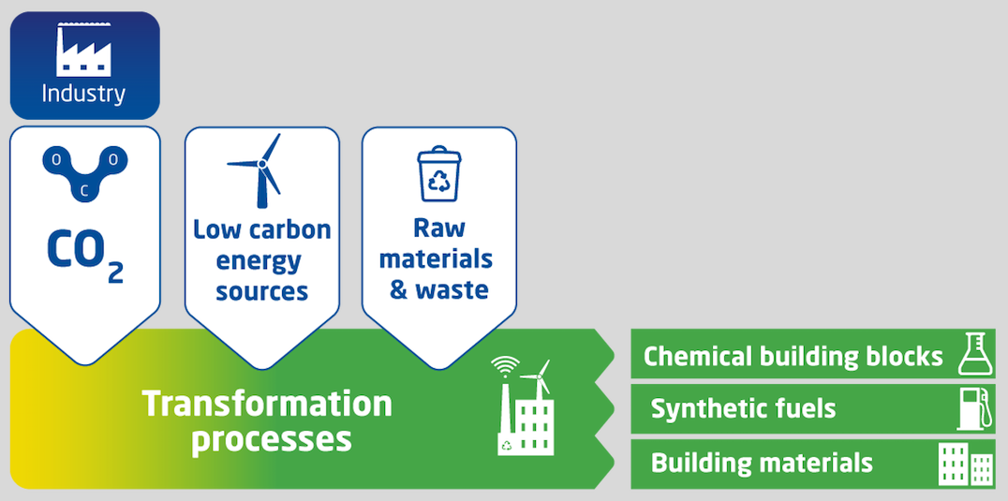
CO₂ Value Europe integrates stakeholders from the complete CCU value chain across industries
The only European association that brings together partners committed to CO₂ Utilisation from all industrial sectors across the value chain
60+ members
15 large
corporations, 16 SMEs, 5 Clusters, 15 Research Institutions, 10 Universities
Mission
Promote the development and market deployment of sustainable industrial solutions that convert CO₂ into valuable products, in order to contribute to the net reduction of global CO₂ emissions and to the diversification of the feedstock base.

Slide 23
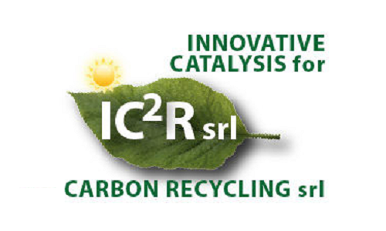
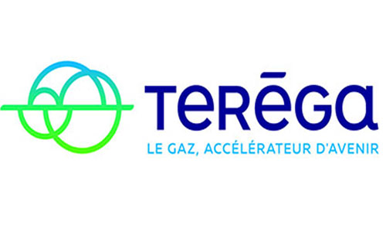
Our members

Slide 24
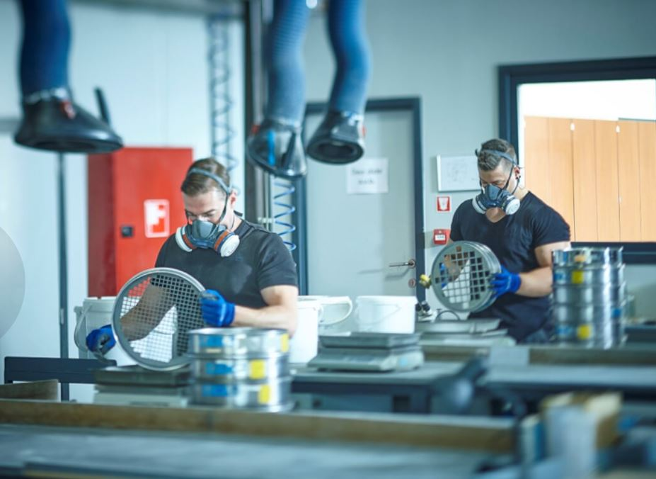
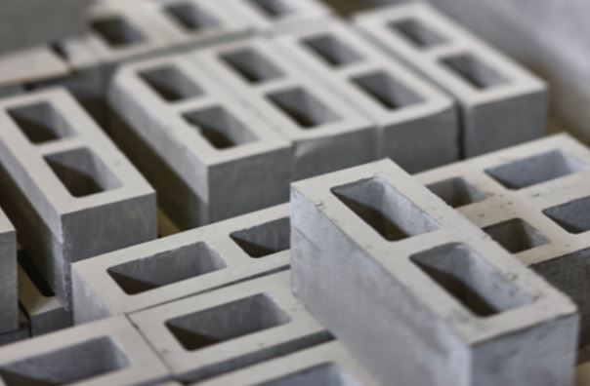
Dr. Eng. Ghania Ounoughene
R&D Project Engineer
Orbix
www.orbix.be
Orbix,
Passion for Innovation

